Slide 1

PalliCare

Slide 2

Team members
Product Owner Dr. med.
Tobias Steigleder
Scrum Master Malte Ollenschläger, M. Sc.
Imrana Abdullahi Yari, M. Sc.
Developer Klaus Schmidt
Insa Suchantke
Daniel Wagner
Patrick Höfner
Ulla Sternemann

Slide 3
Palliative Care
Improve quality of life
pain
physical
psychometric
[1]
17.12.2019 | Klaus Schmidt | MAD-Lab | PalliCare
Notes:
Some of you may have seen palliative station in hospitals. That’s def. a part of palliative care, but there’s far more.
As defined by by the WHO
Palliative care is an approach that improves the quality of life of patients and their families through the prevention and relief of suffering
Apart from pain treat you also try to cure physiologic or psychosocial problems.
https://www.who.int/cancer/palliative/definition/en/

Slide 4
Palliative Care patients
→ seriously ill and dying people
Cancer
Neurological problems
Circulatory diseases
[2]
17.12.2019 | Klaus Schmidt | MAD-Lab | PalliCare
Notes:
Palliative medicin takes care of dying and seriously ill people, with a high symptom burden
In a study from Radbruch around 65% of cases suffered from cancer, in 30% a disease of the circulatory system was diagnosed and 5% had a neurological disease. 0.3 percent are left with other sufferings.
RadbruchL,AndersohnF,WalkerJ(2015)Fak-tencheck Gesundheit. Palliativversorgung Modul3: Überversorgung kurativ – Unterversorgungpalliativ? Analyse ausgewählter Behandlun-gen am Lebensende.https://www.bertelsmann-stiftung.de/fileadmin/files/BSt/Publikationen/GrauePublikationen/Studie_VV__FCG_Ueber-Unterversorgung-palliativ.pdf.Zugegriffen:6Aug2016
Most of palliative care patients are between 70-79 years with an average around 70 years, as stated by the Robert Koch Institut in 2015.
https://www.rki.de/DE/Content/Gesundheitsmonitoring/Gesundheitsberichterstattung/GesInDtld/gesundheit_in_deutschland_2015.pdf?__blob=publicationFile

Slide 5
Palliative accounting cases
palliative accounting cases in hospitals
[3]
17.12.2019 | Klaus Schmidt | MAD-Lab | PalliCare
Notes:
While in 2006 around 15k cases were accounted in german palliative care departmens this number doubled within 8 years to around 33k cases determined by the RKI in 2015.
They also state that further action is needed to connect all palliative care parties to improve service for patients -> WE fit into

Slide 6
Current challenges
Homecare
Limited time
17.12.2019 | Klaus Schmidt | MAD-Lab | PalliCare
Notes:
We identified 2 big challenges:
- Homecare:patients don’t want to be in hospitals, they’d rather be in their familiar environment for different reasons.
- Palliative Care services as well as doctors have to deal with more and more patients in the same time.

Slide 7
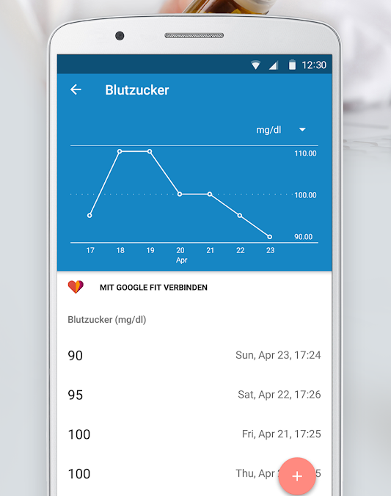
Existing solutions
SwissVoice C50
Koala Phone Launcher
Alberta
Medisafe Alarm
[4]
17.12.2019 | Klaus Schmidt | MAD-Lab | PalliCare
Notes:
Interfaces for elderly people:Launcher or even whole phones with big buttons, easy structure
App for palliative care services to manage the patients they need to visit or buy patient specific equipment
Medisafe Alarm which can remind to take pills, visualize biometric data but not focused on elderly palliative patients from design and does not allow to assess psychometric data.
https://play.google.com/store/apps/details?id=com.medisafe.android.client&hl=de

Slide 8
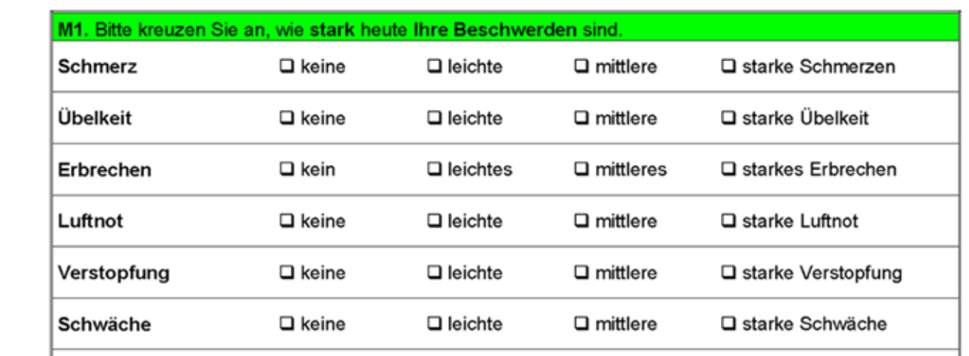
Psychometric data
MIDOS
brief and simple
10 questions
4 answer possibilities
custom notes
[5]
17.12.2019 | Klaus Schmidt | MAD-Lab | PalliCare
Notes:
* Midos Questionnaire

Slide 9
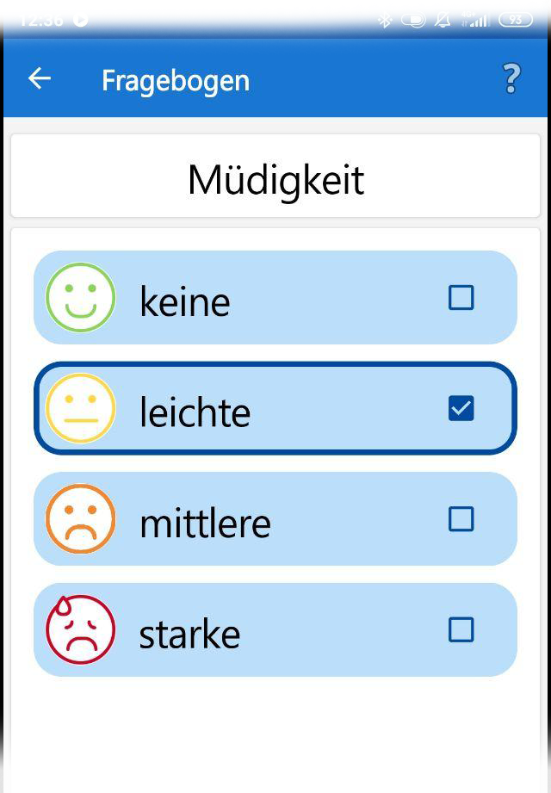
Psychometric data
MIDOS
brief and simple
10 questions
4 answer possibilities
custom notes
17.12.2019 | Klaus Schmidt | MAD-Lab | PalliCare
Notes:
* Midos Questionnaire

Slide 10
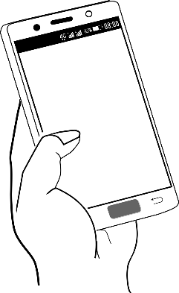





Overview
of Kin
Next
Doctor
Remote storage
Local storage
Patient
Psychometric data
Biometric data
17.12.2019 | Insa Suchantke | MAD-Lab | PalliCare
Notes:
Klaus: State of the Art & MIDOS
PERMISSION
Health data
Our project
palliative outpatient care (team)

Slide 11
Overview
of Kin
Next
Doctor
Remote storage
Local storage
Patient
Psychometric data
Biometric data
17.12.2019 | Insa Suchantke | MAD-Lab | PalliCare

Slide 12
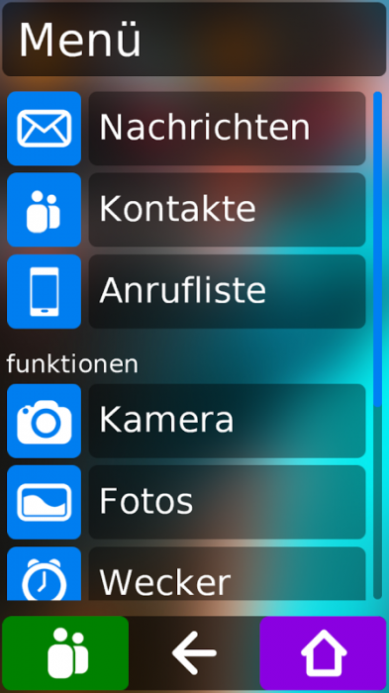
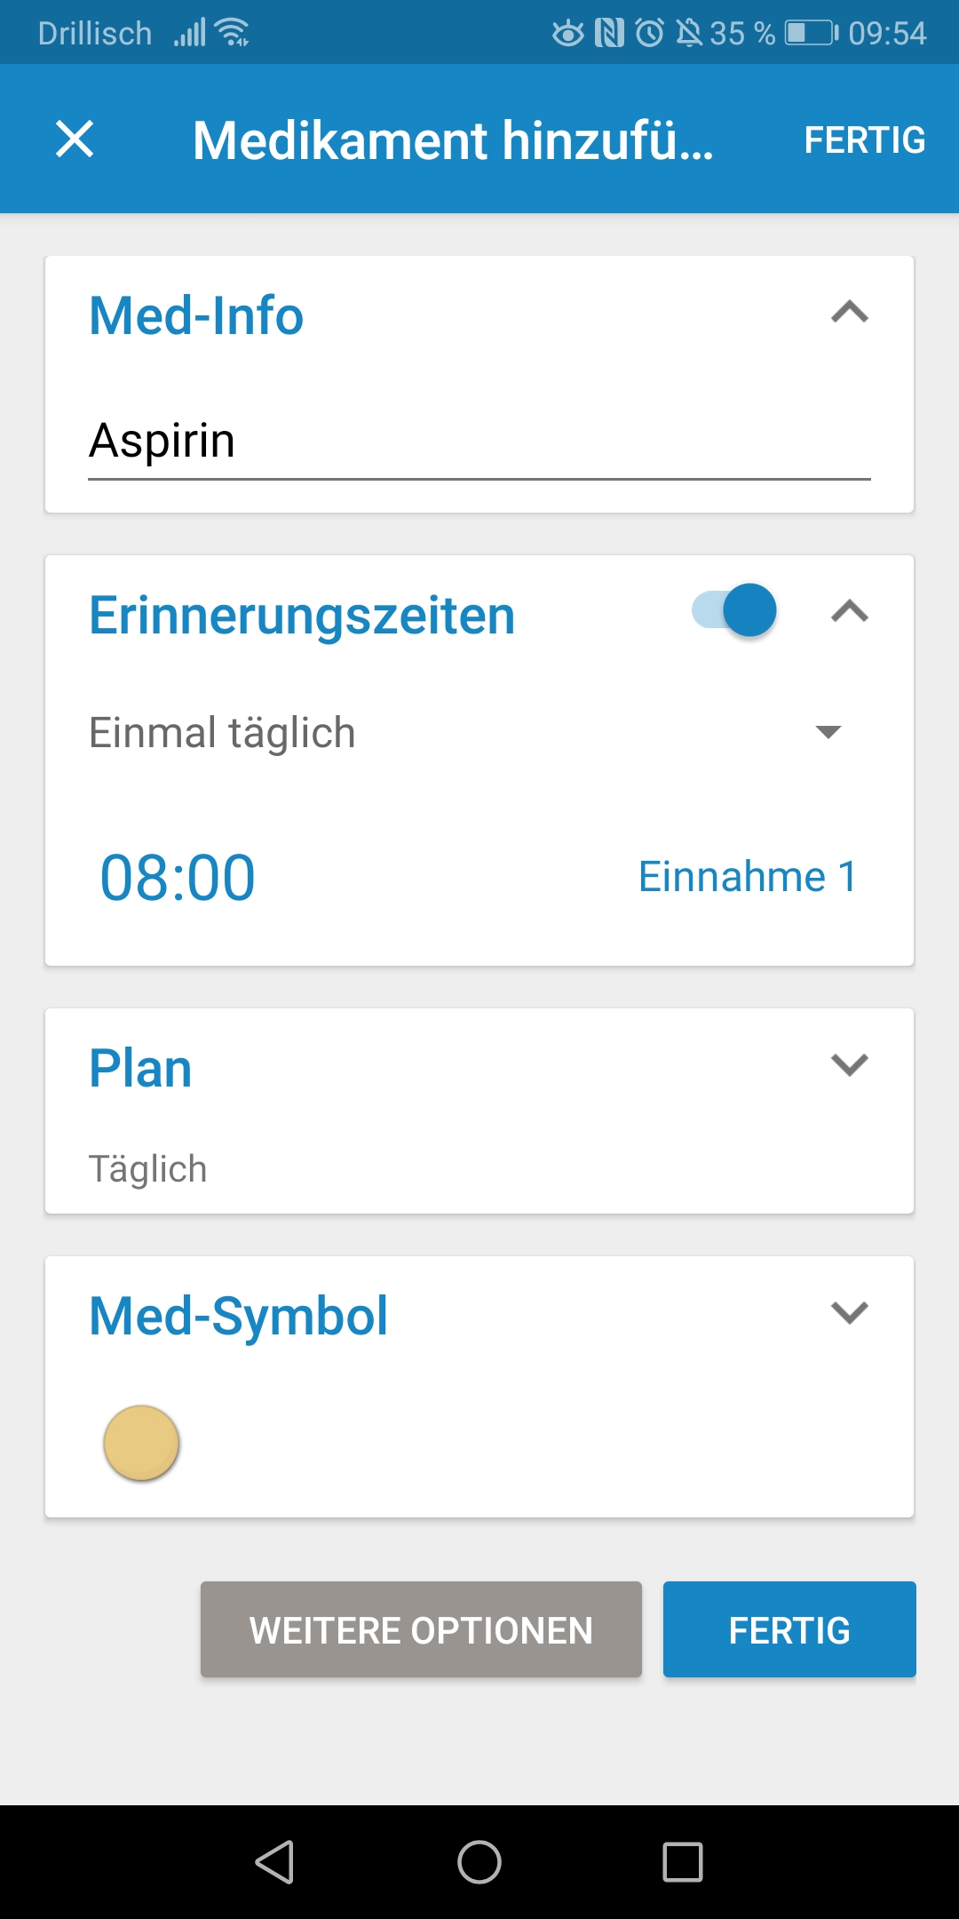
Design decisions
Simple menu
Good contrast
Large buttons
Icons
Card layout
Good legibility
[6]
[7]
17.12.2019 | Insa Suchantke | MAD-Lab | PalliCare
Notes:
Koala Launcher, Medisafe
Deal with, inspired, familiar
illustrate
First: haven‘t cared about layout
65+ years → research what Apps are on market or elderly people
Summary of important things
Contrast: use color blue
Icons → support understanding
Understandable text: not too long, but not too short, so they can understand

Slide 13



Design decisions - Interview
Build trust and acceptance
Avoid confusion
Easy understanding of the content
17.12.2019 | Insa Suchantke | MAD-Lab | PalliCare
Notes:
Valuable feedback
2 men from: Forschungsbeirat of the Pallativmedicine of the Univeristätsklinikum (research advisory board)
Opportunity
Patient feels unterstood and fears that she/he is beeing experimented on
We want the app to be simple and structured to avoid patient confusion.
Avoid confusions (Verwirrung vermeiden)→ less text & good comprehensibility
Easy understanding of the content → comprehensibility

Slide 14
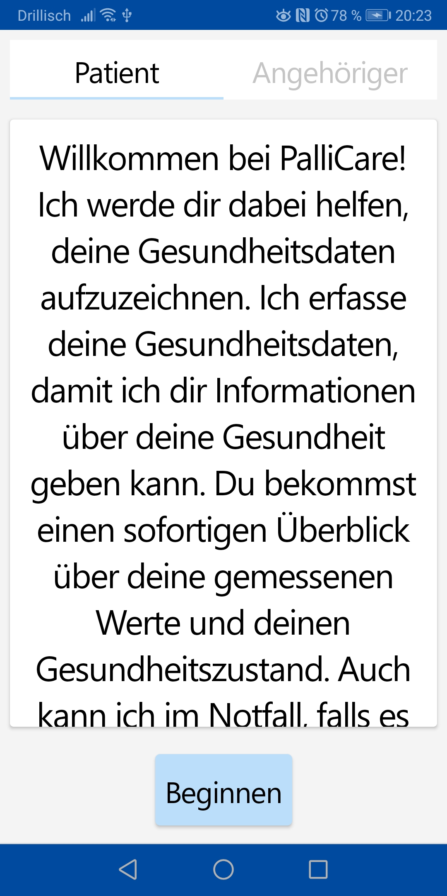
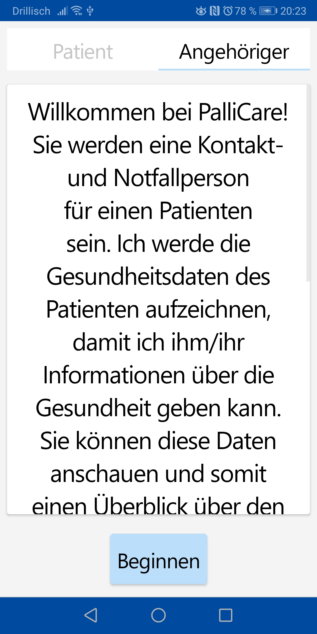
Welcome screen
17.12.2019 | Insa Suchantke | MAD-Lab | PalliCare
Notes:
Trustworthiness
Control → explain exactly why we need this and that
See goal of app
Personal but not too much
Short and get to the point
describes what the app does without explicitly specifying how to use the app
ICONS

Slide 15
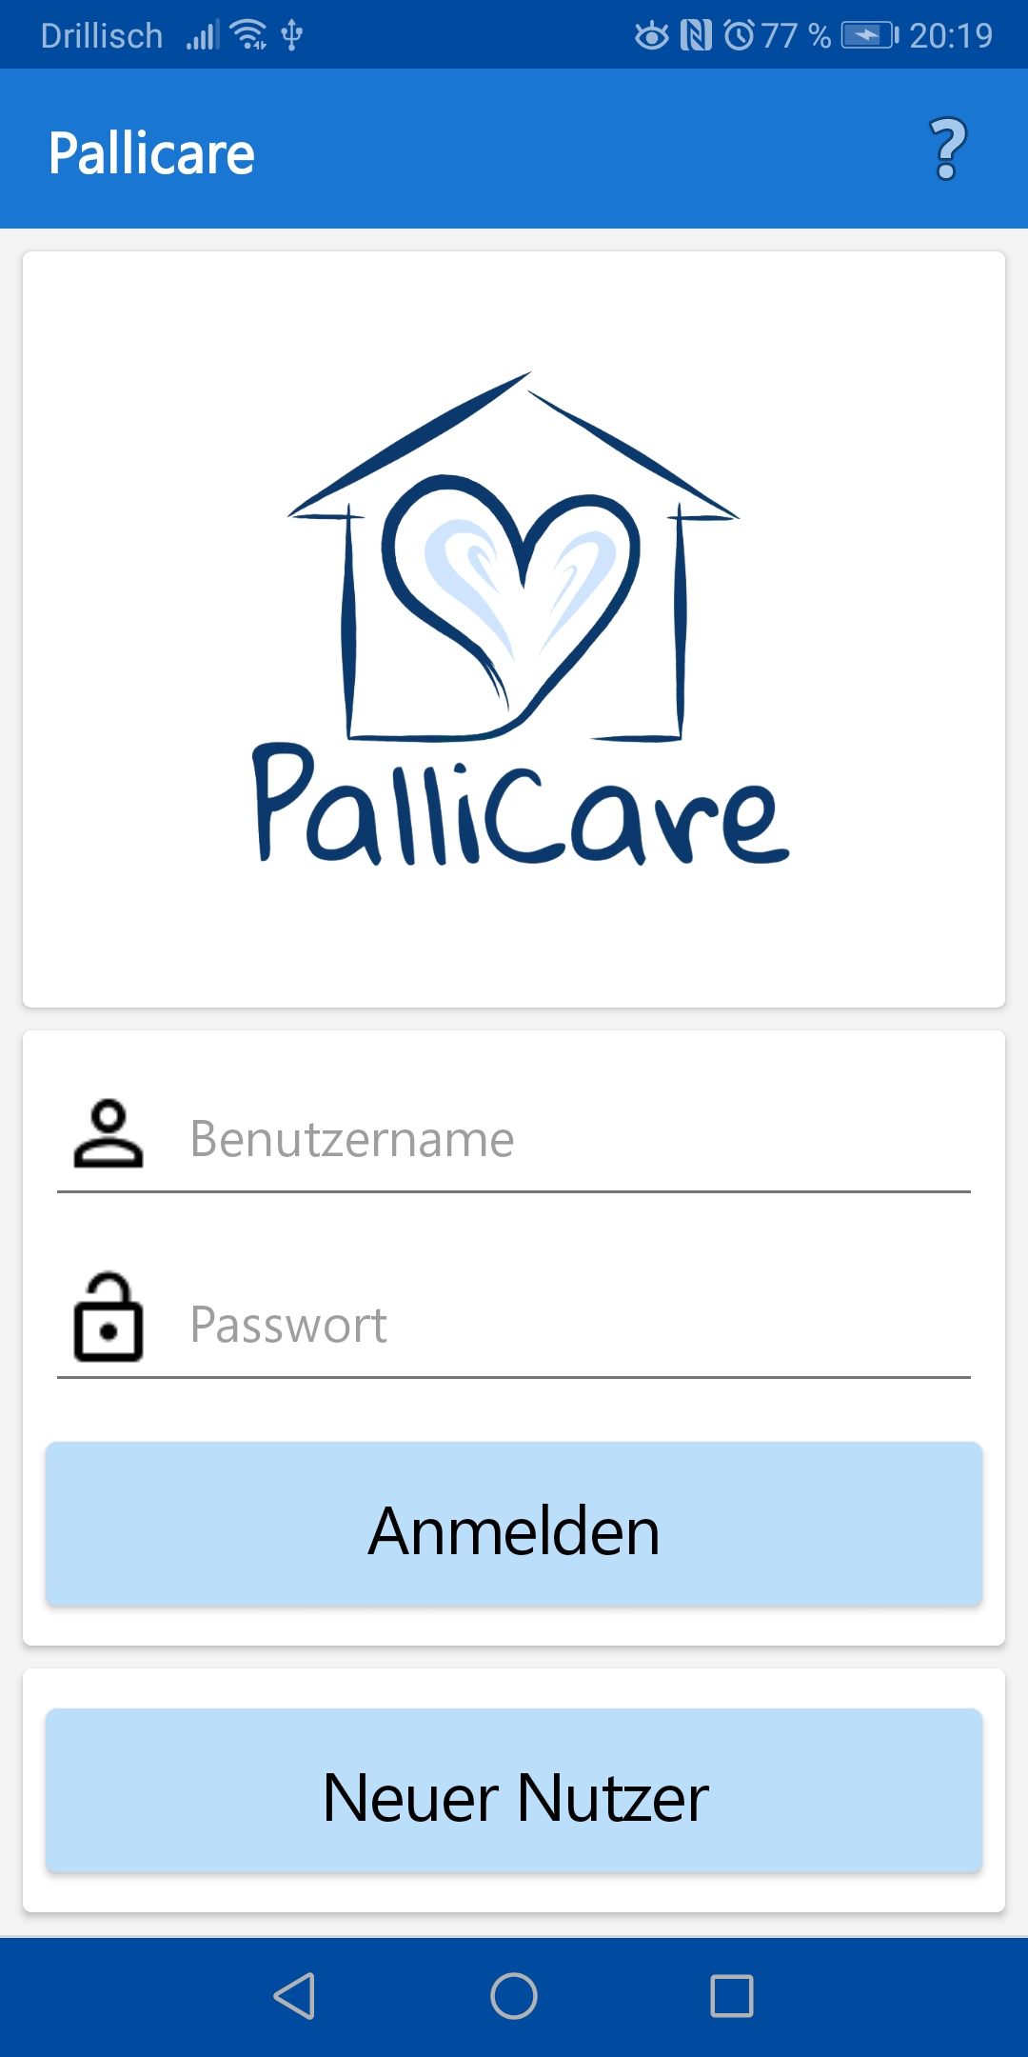
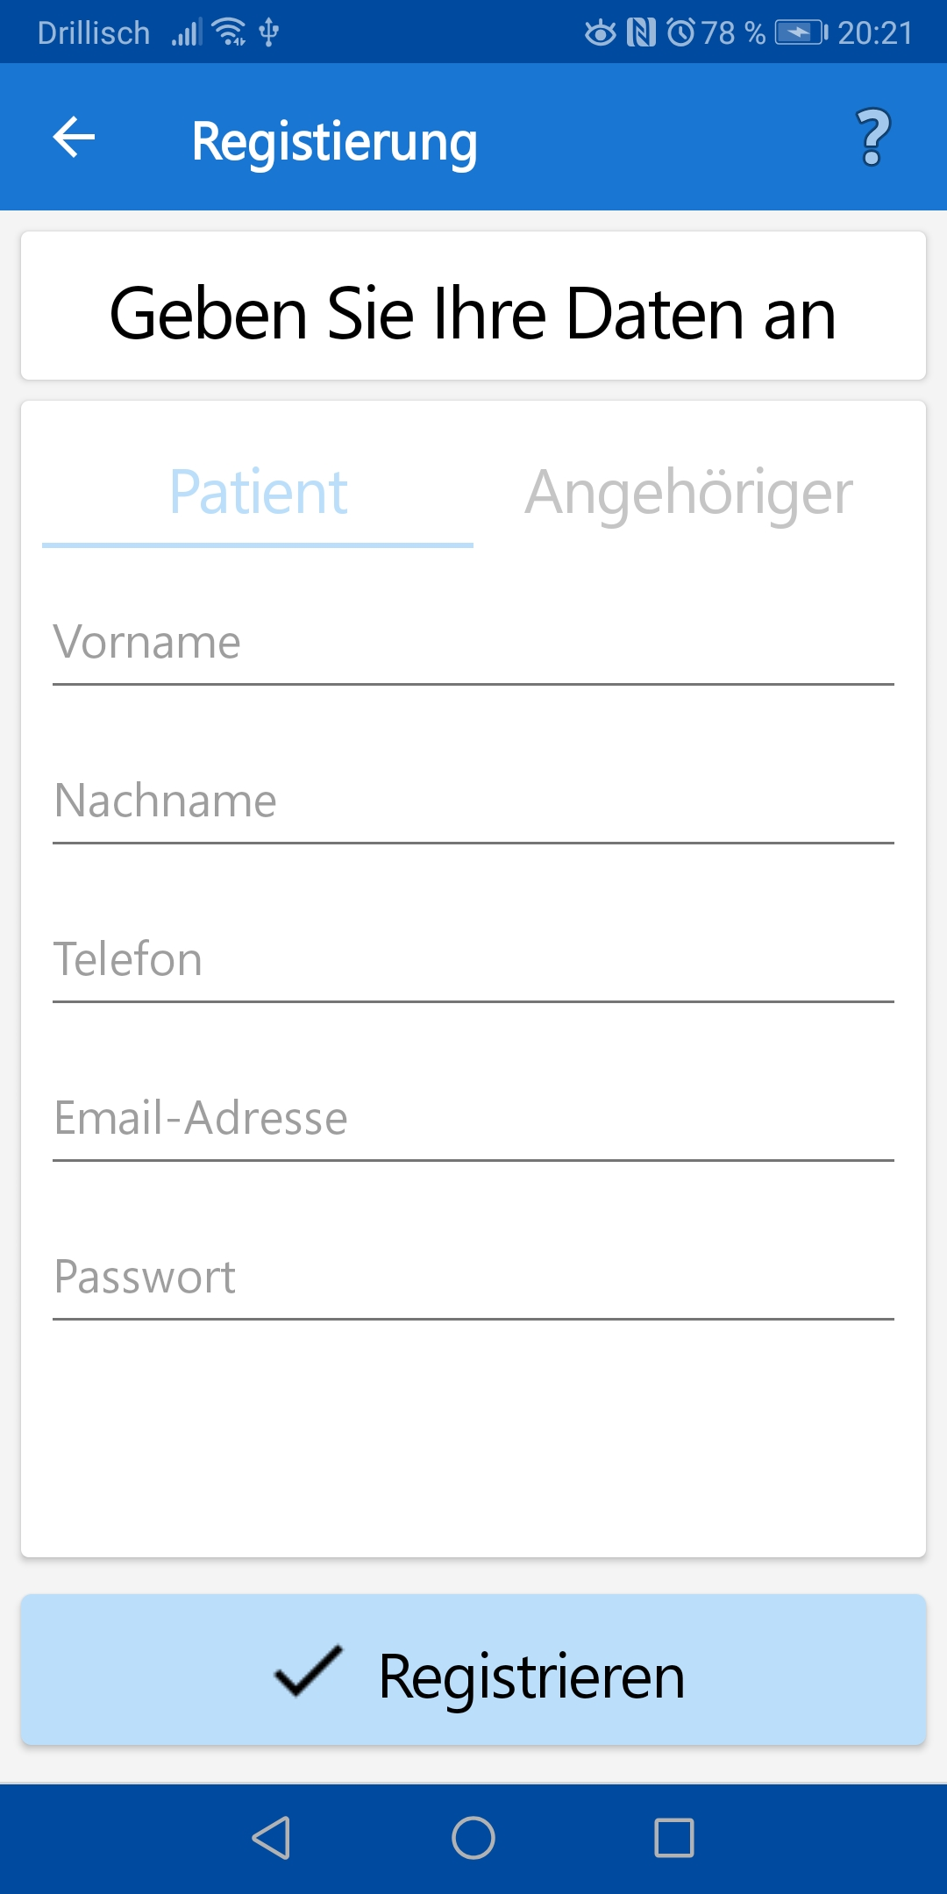
Registration screen
17.12.2019 | Insa Suchantke | MAD-Lab | PalliCare
Notes:
ICONS

Slide 16
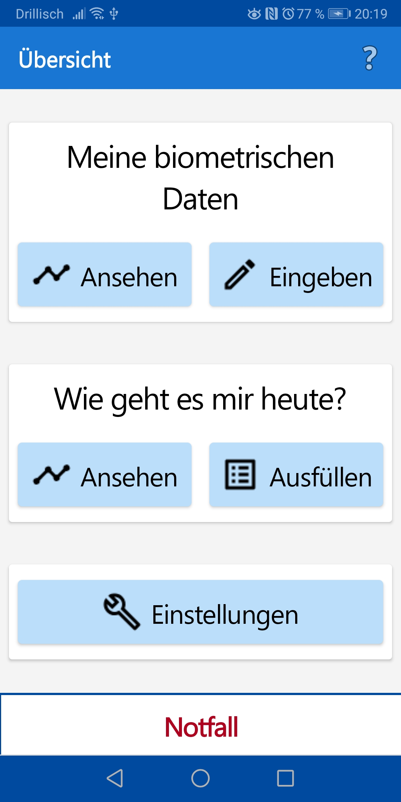
Overview screen
17.12.2019 | Insa Suchantke | MAD-Lab | PalliCare
Notes:
One of the important things about our app

Slide 17
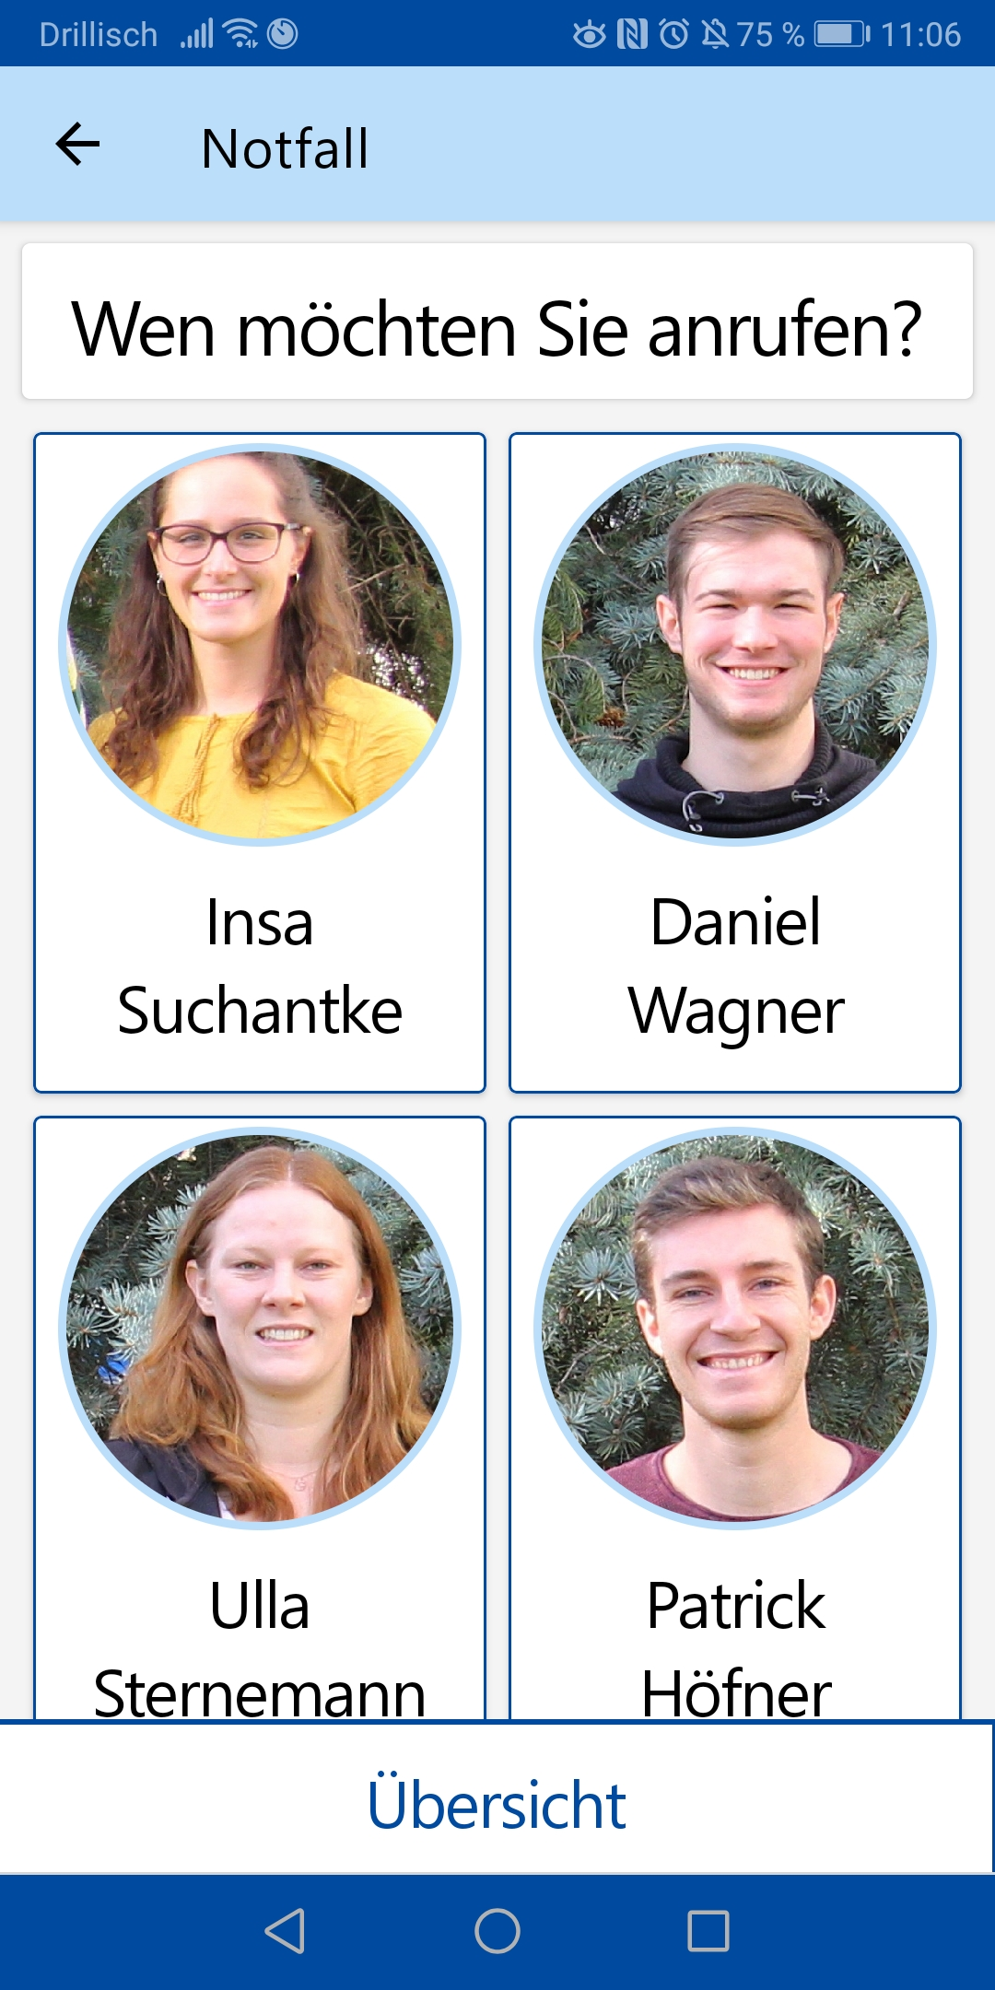
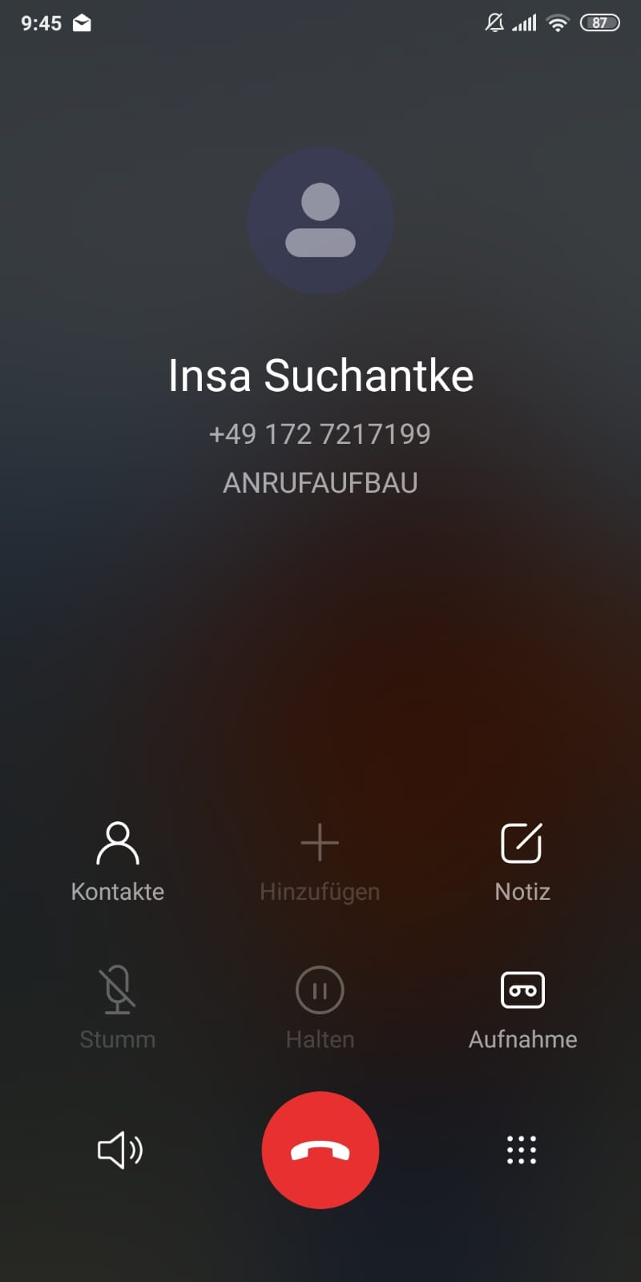
Emergency screen
17.12.2019 | Insa Suchantke | MAD-Lab | PalliCare
Notes:
Showing all „Notfall“ contacts
deposit
by clicking on it → contact is called
Multiple selections
Larger font and larger buttons
On nearly every screen visible

Slide 18
Overview
of Kin
Next
Doctor
Remote storage
Local storage
Patient
Psychometric data
Biometric data
17.12.2019 | Daniel Wagner | MAD-Lab | PalliCare

Slide 19
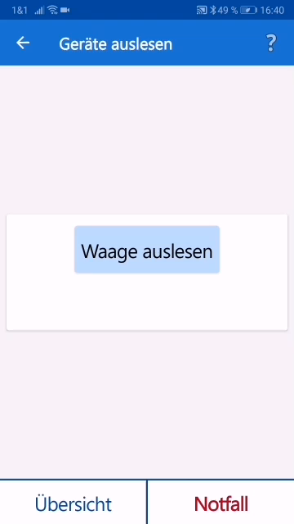
Demonstration
17.12.2019 | Daniel Wagner | MAD-Lab | PalliCare
Notes:
Left Screenshot:
Screen with Overview about all Sufferings and Average Value over a certain Time
Scrollview
Average-Value
Buttons for Detailed Information
Right Screen:
Detailed View over one Week / Month / Year
Chart for displaying Trendline over Time
All important information within one Screen
Easy readable

Slide 20

Device selection
Choose from many solutions
Define task clearly
Research devices
Propose integration
Validate
Purchase optimal product
17.12.2019 | Daniel Wagner | MAD-Lab | PalliCare
Notes:
Left Screenshot:
Screen with Overview about all Sufferings and Average Value over a certain Time
Scrollview
Average-Value
Buttons for Detailed Information
Right Screen:
Detailed View over one Week / Month / Year
Chart for displaying Trendline over Time
All important information within one Screen
Easy readable

Slide 21

Device measurement access
[8]
Encrypted data poses a problem
17.12.2019 | Daniel Wagner | MAD-Lab | PalliCare

Slide 22
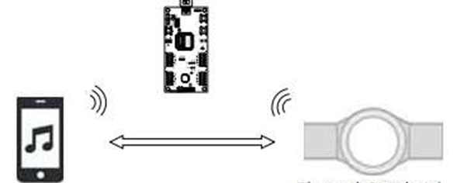
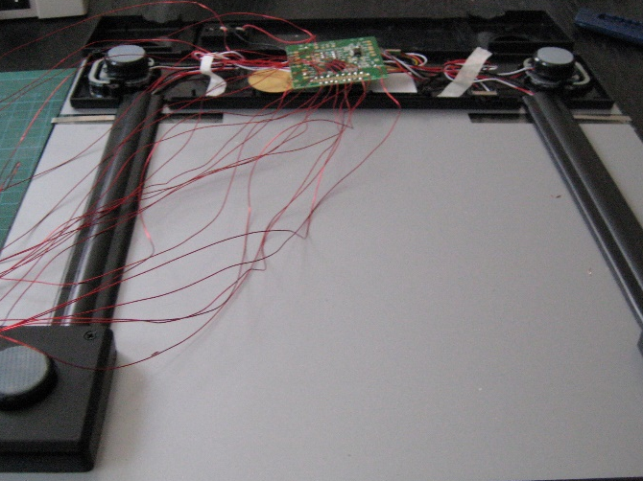
Device „hacking“ options
Bluetooth sniffing
Hardware level access
[9]
[10]
Requires immense time
17.12.2019 | Daniel Wagner | MAD-Lab | PalliCare

Slide 23





Manufacturer cooperation
[13]
[14]
[15]
[12]
[11]
Privacy concerns prevent any cooperation
17.12.2019 | Daniel Wagner | MAD-Lab | PalliCare

Slide 24
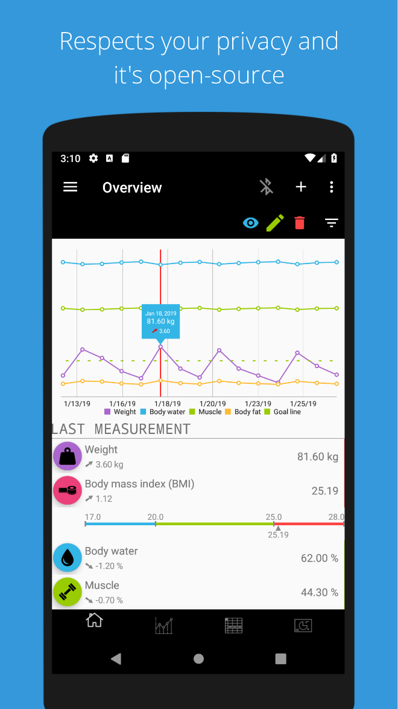
Open Source community projects
Openscale
BLE drivers adapted
BLE logging fused
Data management detached
[16]
17.12.2019 | Daniel Wagner | MAD-Lab | PalliCare

Slide 25
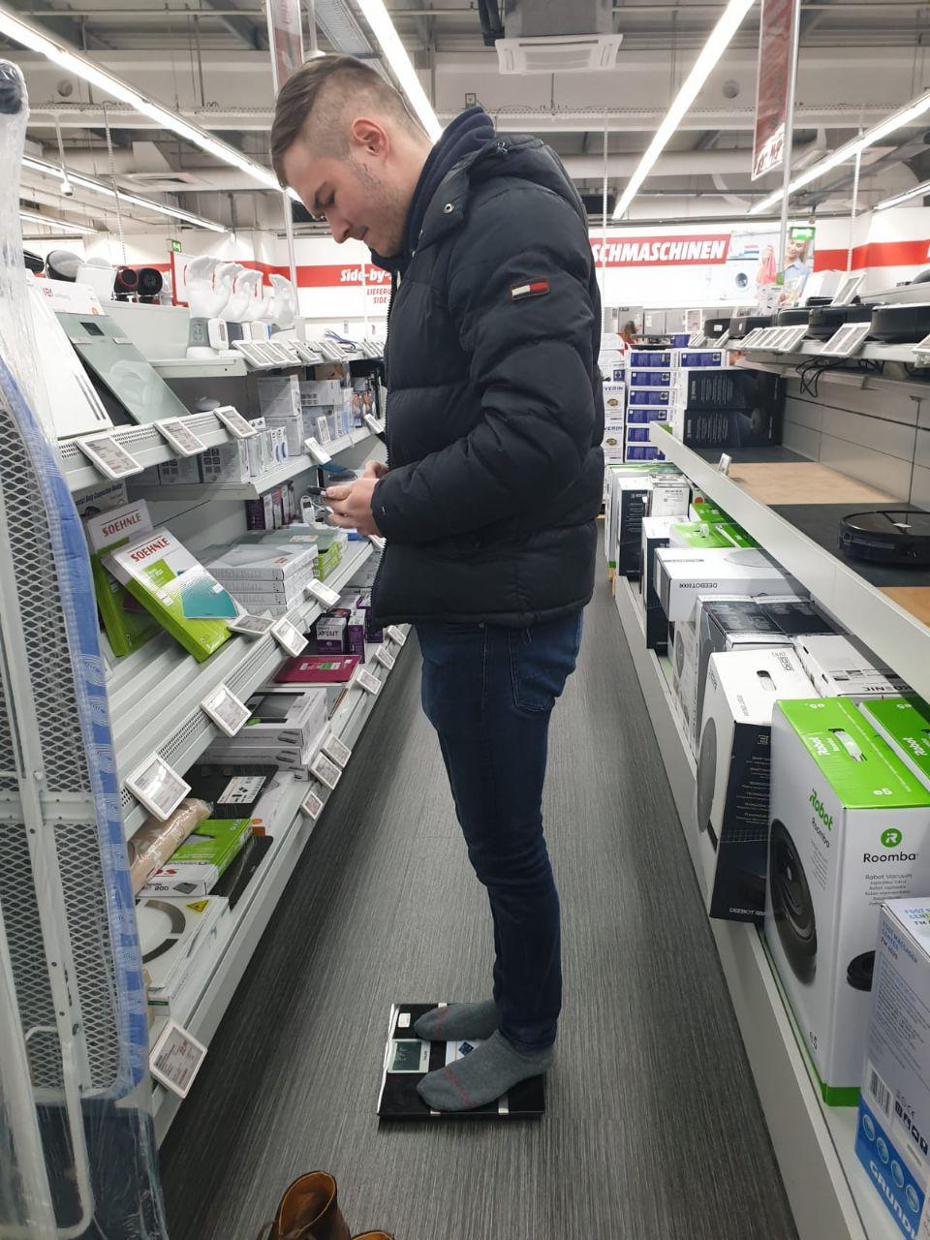
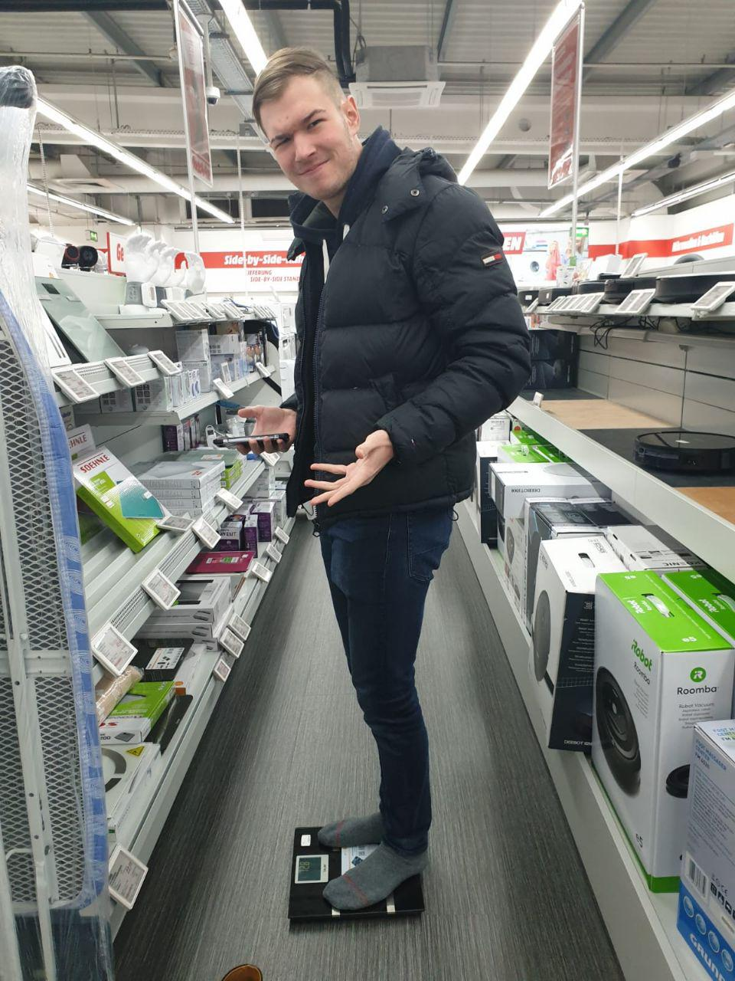
Validation and purchase
17.12.2019 | Daniel Wagner | MAD-Lab | PalliCare

Slide 26

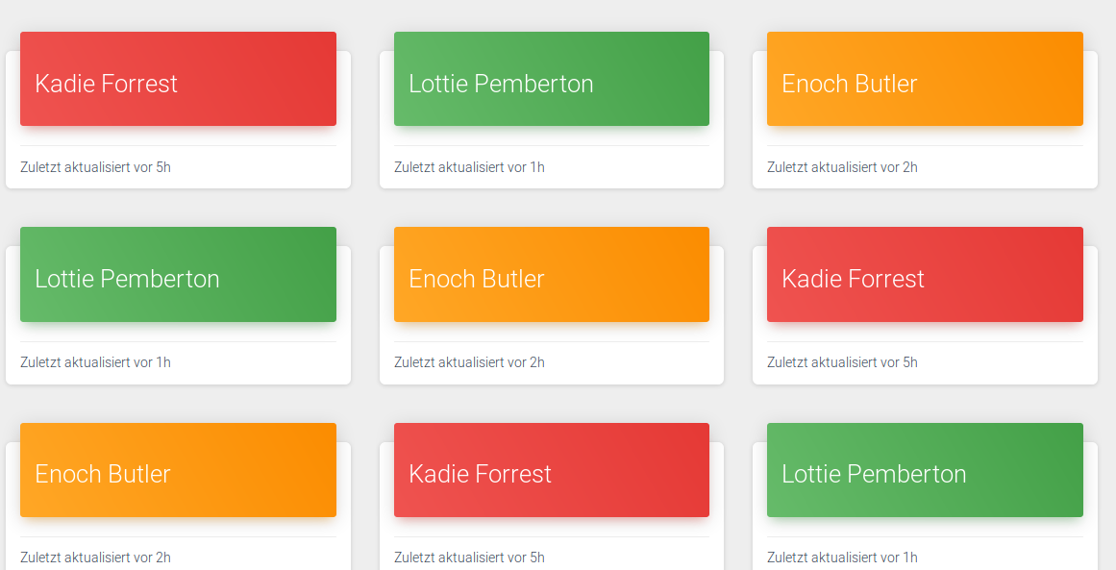
Frontend: What the doctor sees
[17]
17.12.2019 | Daniel Wagner | MAD-Lab | PalliCare

Slide 27

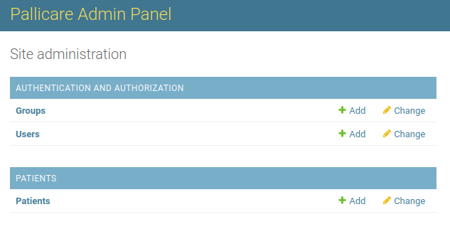
Backend: What the admin sees
[18]
17.12.2019 | Daniel Wagner | MAD-Lab | PalliCare

Slide 28
Overview
of Kin
Next
Doctor
Remote storage
Local storage
Patient
Psychometric data
Biometric data
17.12.2019 | Patrick Höfner | MAD-Lab | PalliCare
Notes:
Key Feature
In the next step present the information to the user

Slide 29
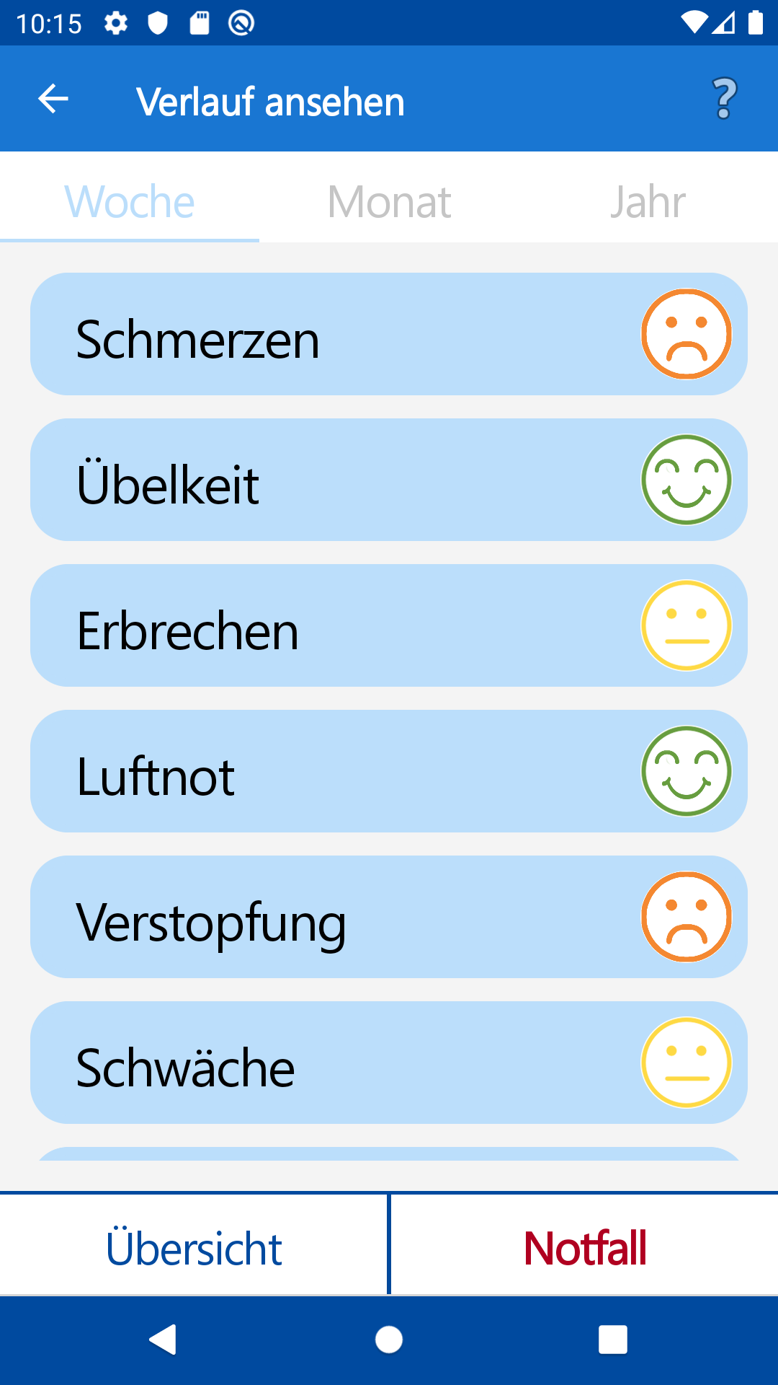
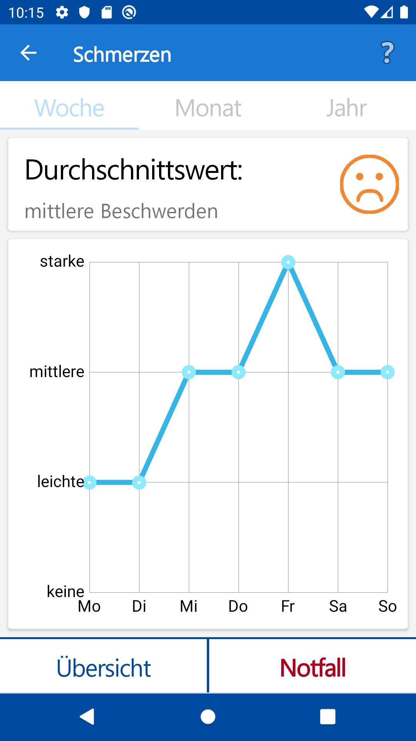
Psychometric information
17.12.2019 | Patrick Höfner | MAD-Lab | PalliCare
Notes:
Left Screenshot:
Screen to display Overview about all Sufferings and Average value over a certain period of time
Scrollview
Average-Value
Each column represents one button, which leads to page for detailed (more granular) Information
Right Screen:
Detailed View over one Week / Month / Year
LineChart for displaying Trendline over Time
Aim: - All important information within one Screen
Easy readable for our target-group
Help Button:
- To get useful Information

Slide 30
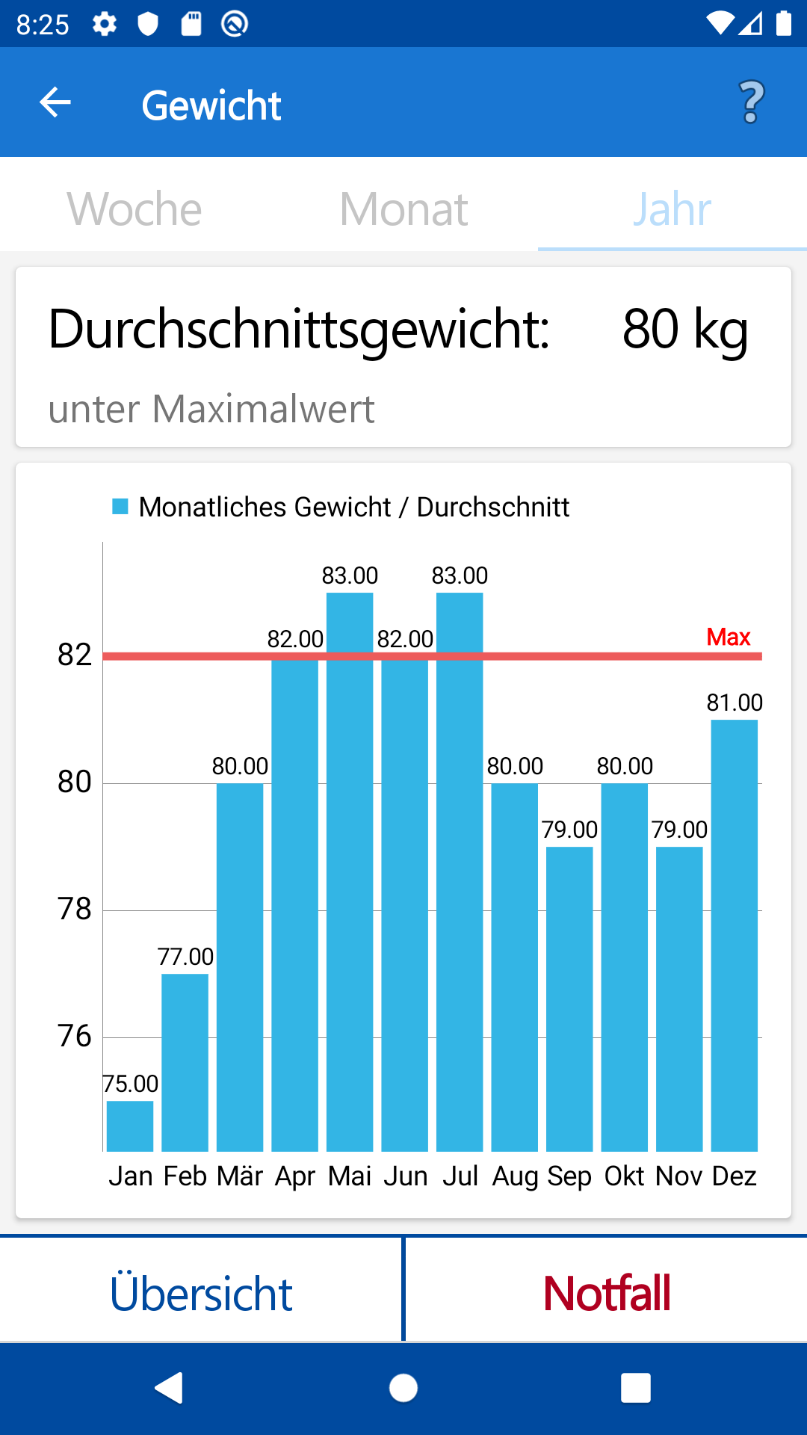
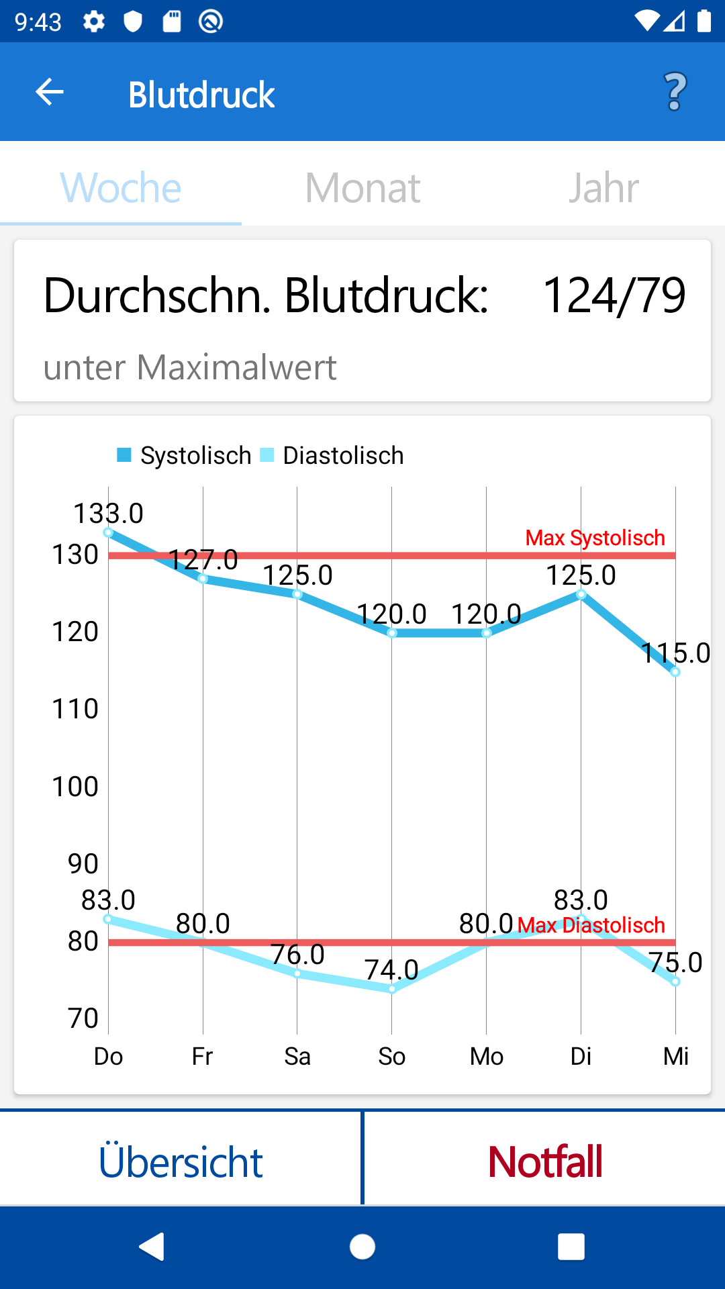
Biometric information
17.12.2019 | Patrick Höfner | MAD-Lab | PalliCare
Notes:
Weight:
Barchart over week / month / year
Barchart works well for displaying absolute values
Max-Line
Bloodpressure:
2 Lines for displaying systolic and diastolic value
Help Button in Toolbar to provide useful information about values
- Opportunity to input individual max-Bloodpressure and Weight

Slide 31
Overview
of Kin
Next
Doctor
Remote storage
Local storage
Patient
Psychometric data
Biometric data
17.12.2019 | Patrick Höfner | MAD-Lab | PalliCare
Notes:
Connecting Participants:
- To have the opportunity to share Data between trusted users (Patients with Doctor and Next-of-Kin
Provide Doctors Web-Frontend
- And furthermore to provide a web frontend for the doctor

Slide 32
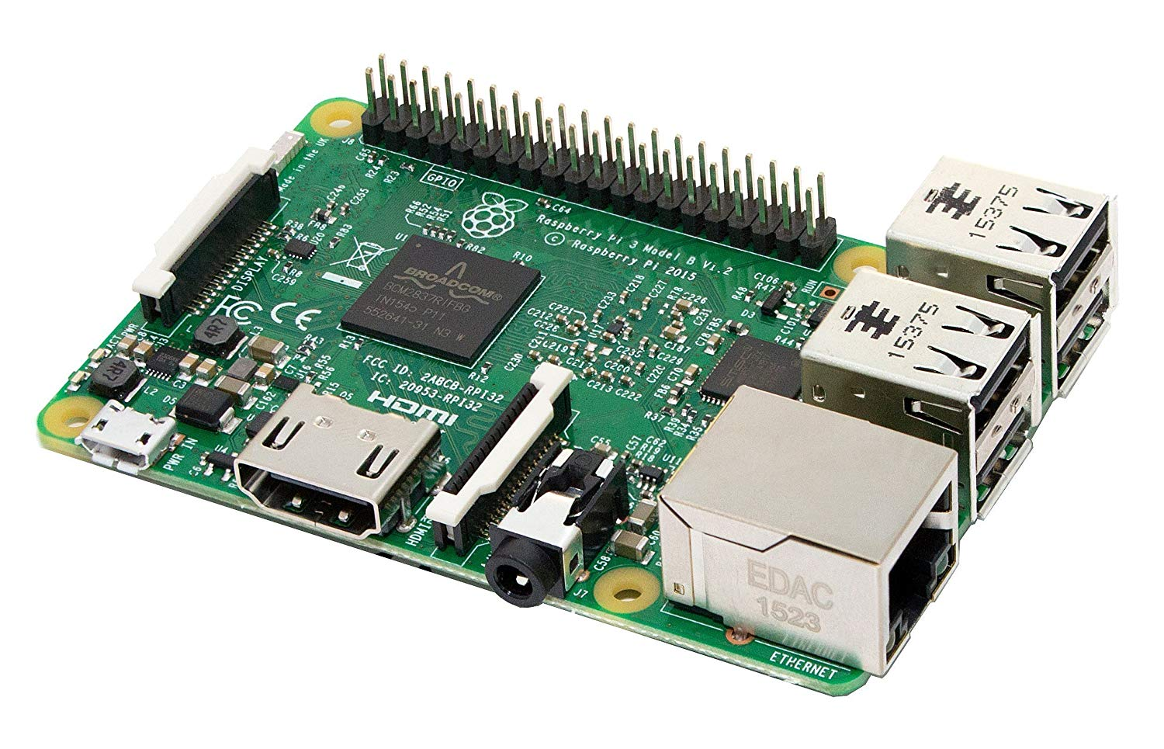
Webserver hardware
[19]
17.12.2019 | Patrick Höfner | MAD-Lab | PalliCare
Notes:
Why Raspberry Pi Model 3B?
Independency (opportunity to use open source software)
Medical information in cloud service not trustworthy
Use case to provide an all in one System

Slide 33




Webserver software
Backend
REST API
Frontend
[20]
[21]
[22]
[23]
Centralised DBMS
Authentication User management
Permission handling
Rendering
Website interaction
17.12.2019 | Patrick Höfner | MAD-Lab | PalliCare
Notes:
REST-API
Manage Communication between Server and Client
- Django REST API can also be used to manage connection between Android-Application and Backend
Backend:
Django on top of MariaDB
Centralised Database:
To have a data storage, where the data can be saved persistently and centralised
Connect different devices
User-Management
- To provide an authentication System for Registration and Login
Permission Handling
- Right-Management for accessing specific Data or change/insert data (read/write privileges)
(Data-Mining)
- Only users which have an appropiate permission should be able to get access to the data
React JS
Javascript-Libary to create Frontends

Slide 34

Webserver security
Encrypted communication between server and client
SSL certificate from LetsEncrypt
[24]
17.12.2019 | Patrick Höfner | MAD-Lab | PalliCare
Notes:
Current State
HTTPS (SSL-Encryption)
- Encrypt the communication between server and client
- Usage of an Certificate from Letsencrypt
Actual deveolopment Process
Add the functionality to the webserver to connect the different parts to get a closed System
Manage encryption and Security
Django takes care a lot

Slide 35
Overview
of Kin
Next
Doctor
Remote storage
Local storage
Patient
Psychometric data
Biometric data
17.12.2019 | Ulla Sternemann | MAD-Lab | PalliCare

Slide 36



Data storage
Remote storage
Local storage
[26]
[25]
[27]
17.12.2019 | Ulla Sternemann | MAD-Lab | PalliCare

Slide 37
Database structure
device_type
permission_type
device
permission
user_type
user
questionnaire
other_suffering
measurement_scale
measurement_bloodpressure
17.12.2019 | Ulla Sternemann | MAD-Lab | PalliCare

Slide 38




Providing feedback
Biometric data
Psychometric data
Expert knowledge
Analysis of available datasets
17.12.2019 | Ulla Sternemann | MAD-Lab | PalliCare

Slide 39


Goal
of Kin
Next
Patient
Doctor
Homecare
Limited time
17.12.2019 | Ulla Sternemann | MAD-Lab | PalliCare

Slide 40




Outlook
Integrate more medical devices
Improve accessibility
Provide route planning for outpatient care teams
17.12.2019 | Ulla Sternemann | MAD-Lab | PalliCare

Slide 41
Thank you for your attention!

Slide 42
Bibliography
[1] WHO Definition of Palliative Care. https://www.who.int/cancer/palliative/definition/en/ (last accessed 16.12.2019).
[2] Radbruch L., Andersohn F., Walker J. Faktencheck Gesundheit. Palliativversorgung Modul 3: Überversorgung kurativ – Unterversorgung palliativ? Analyse ausgewählter Behandlungen am Lebensende. 2015. https://www.bertelsmann-stiftung.de/fileadmin/files/BSt/Publikationen/GrauePublikationen/Studie_VV__FCG_Ueber-Unterversorgung-palliativ.pdf (last accessed 16.12.2019), p. 40.
[3] Robert Koch Institut. Gesundheitsberichterstattung des Bundes gemeinsam getragen von RKI und Destatis. Gesundheit in Deutschland. 2015. https://www.rki.de/DE/Content/ Gesundheitsmonitoring/Gesundheitsberichterstattung/GesInDtld/gesundheit_in_deutschland_2015.pdf?__blob=publicationFile (last accessed 16.12.2019), p. 332ff.
[4] Google Play Store. Alarm Medikamenten-Einnahme. https://play.google.com/store/ apps/details ?id=com.medisafe.android.client&hl=de (last accessed 16.12.2019).
[5] Stiel, S., Matthes, M., Bertram, L. et al. Schmerz (2010) 24. Springer-Verlag. https://doi.org/10.1007/s00482-010-0972-5 (last accessed 16.12.2019), p. 596ff.
[6] Aptoide. Koala Phone Launcher Free. https://tomas-slavicek-koala-phone.de.aptoide.com/ (last accessed 13.12.2019).
[7] Apple Inc. App Store-Vorschau. Medisafe Pille Erinnerung. Arzneimittel korrekt einnehmen. MediSafe Inc. https://apps.apple.com/de/app/arznei-medikamente-alarm/id573916946 (last accessed 13.12.2019).
Notes:
Quellen Klaus

Slide 43
Bibliography
[8] Locatify.com. What are BLE Beacons.
https://locatify.com/blog/beacon-faq/ (last accessed 16.12.2019).
[9] Rfwireless-world.com. Bluetooth Sniffer.
https://www.rfwireless-world.com/images/Bluetooth-Sniffer.jpg (last accessed 16.12.2019).
[10] Github.com Openscale project. Building a custom scale. https://github.com/oliexdev/openScale/raw/master/docs/custom_scale/scale_overview_back_wired.JPG (last accessed 16.12.2019).
[11] Rotlichtlampe.com. Boso Rotlichtlampen
https://www.rotlichtlampe.com/boso/ (last accessed 16.12.2019).
[12] Seeklogo.net Omron vector logo free.
https://seeklogo.net/omron-8871.html (last accessed 16.12.2019).
[13] Sanitas-online.de Homepage.
http://www.sanitas-online.de/web/_img/logo_de.gif (last accessed 16.12.2019).
[14] Worldvectorlogo.com. Beurer vector logo.
https://worldvectorlogo.com/logo/beurer (last accessed 16.12.2019).
[15] Medisana.com. Homepage Logo. https://www.medisana.com/out/medisana/img/MedisanaLogo.png (last accessed 16.12.2019).

Slide 44
Bibliography
[16] Github.com. Openscale project description. https://github.com/oliexdev/openScale/blob/master/docs/screens/1_overview.png
(last accessed 16.12.2019)
[17] Pinterest.fr. React JS Sticker. https://www.pinterest.fr/pin/497225615092342857/ (last accessed 16.12.2019).
[18] Splendornet.qa. Django examples. http://splendornet.qa/wp-content/uploads/2019/01/django.png
(last accessed 16.12.2019).
[19] Pi-Shop.ch. Raspberry Pi 3 Model B. https://www.pi-shop.ch/raspberry-pi-3 (last accessed 16.12.2019).
[20] Django Agentur München. Effiziente Django Python Entwicklung. https://www.bizfactory.tech/leistungen/django-agentur-muenchen (last accessed 16.12.2019).
[21] AWS Amazon. Amazon RDS for MariaDB. https://aws.amazon.com/de/rds/mariadb/ (last accessed 16.12.2019).
[22] Django REST Framework. https://www.django-rest-framework.org/ (last accessed 16.12.2019).
[23] Medium. Simple Timer in React https://medium.com/@650egor/react-30-day-challenge-day-1-simple-timer-df85d0867553 (last accessed 16.12.2019).

Slide 45
Bibliography
[24] Wordpress. SSL Insecure Content Fixer. https://de.wordpress.org/plugins/ssl-insecure-content-fixer/ (last accessed 16.12.2019).
[25] MariaDB Foundation. About. https://mariadb.org/ (last accessed 16.12.2019).
[26] Android developers. Achitectures. Room. https://developer.android.com/topic/libraries/architecture/room (last accessed 16.12.2019).
[27] SQLite. https://www.sqlite.org/images/sqlite370_banner.gif (last accessed 16.12.2019).

